Slide 1
Project ASCEND!
Embry-Riddle Aeronautical University
Spring 2014
Presented By:
Ankit Jain – Project Manager

Slide 2
Team Organization
Ankit Jain: Project Manager
Ben Anderson: Assistant Project Manager
Patrick Deskin: System Integrator
Brigette Cochran: Software Engineer
Dallas Hodge: Hardware Engineer
Austin Leonard: Structural Engineer
Loren Williams: Structural Engineer

Slide 3
Presentation Overview
Project Overview
Computer Aided Design (CAD) & Rapid Prototyping
Fabrication
Hardware & Software
Attitude Determination
Flight Results
Future Developments
Acknowledgments

Slide 4
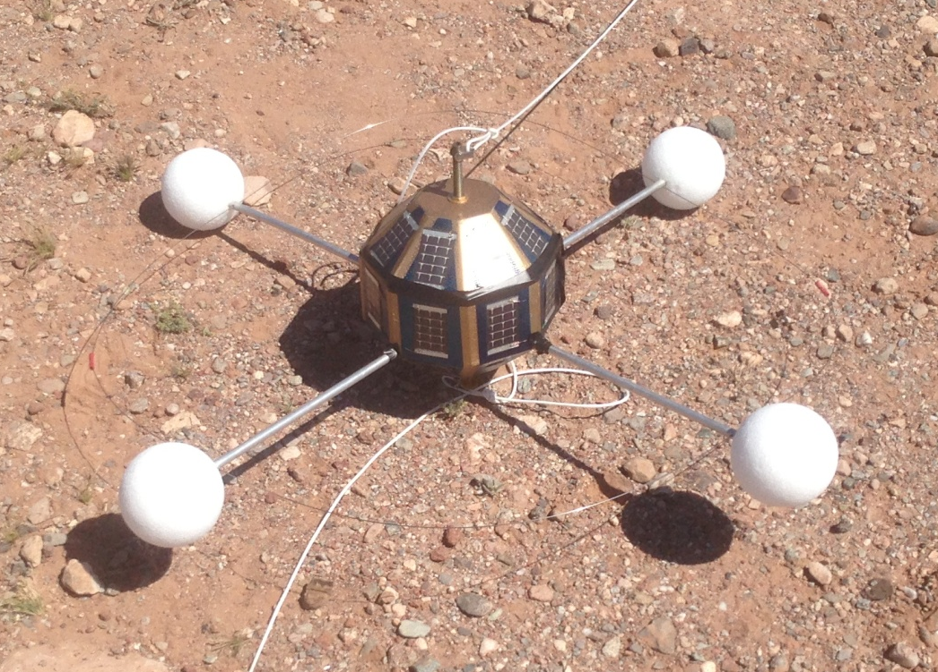
Project Overview
Accurate attitude determination
Real-time implementation
PCB manufacturing
26-sided structure
Booms for stabilization
Standard clamp rod attachment

Slide 5
CAD & Rapid
Prototyping

Slide 6
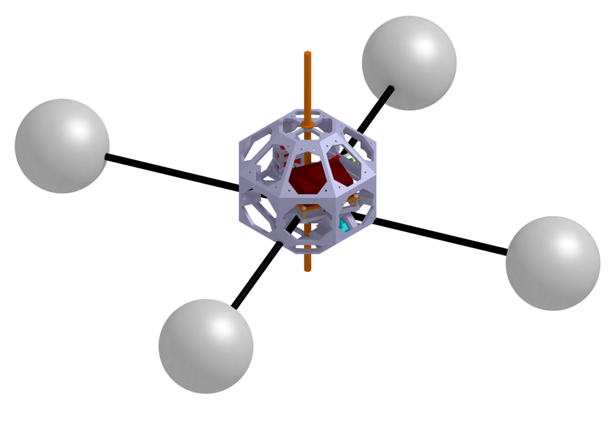
Early CAD Design
CATIA V5 R17

Slide 7
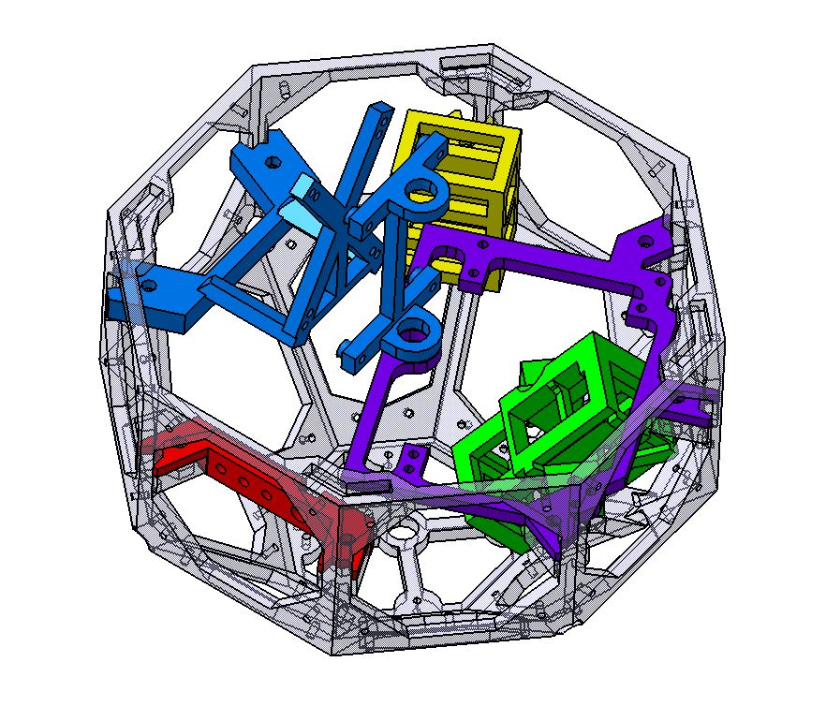
Final CAD Design
Red: Switch Mount
Blue: IMU and Power Regulator Mount
Yellow: 9V Battery Mount
Purple: PCB and Data Logger Mount
Green: Camera Mount

Slide 8
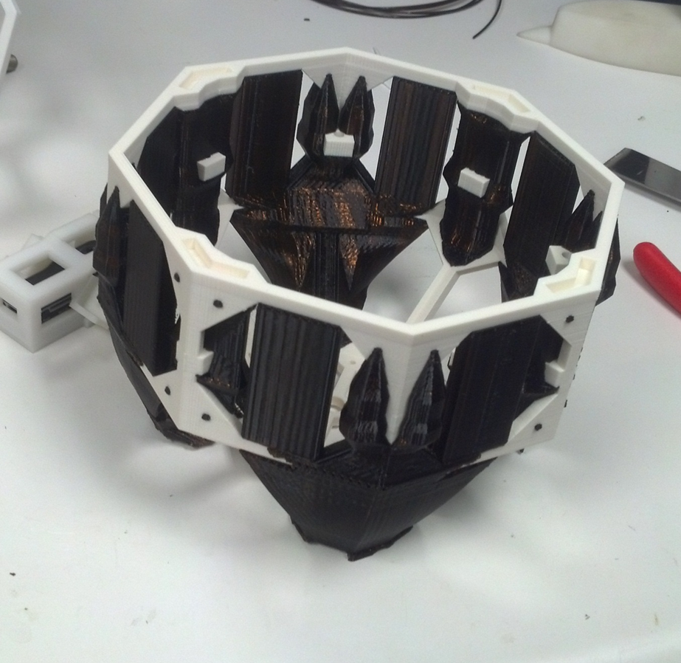
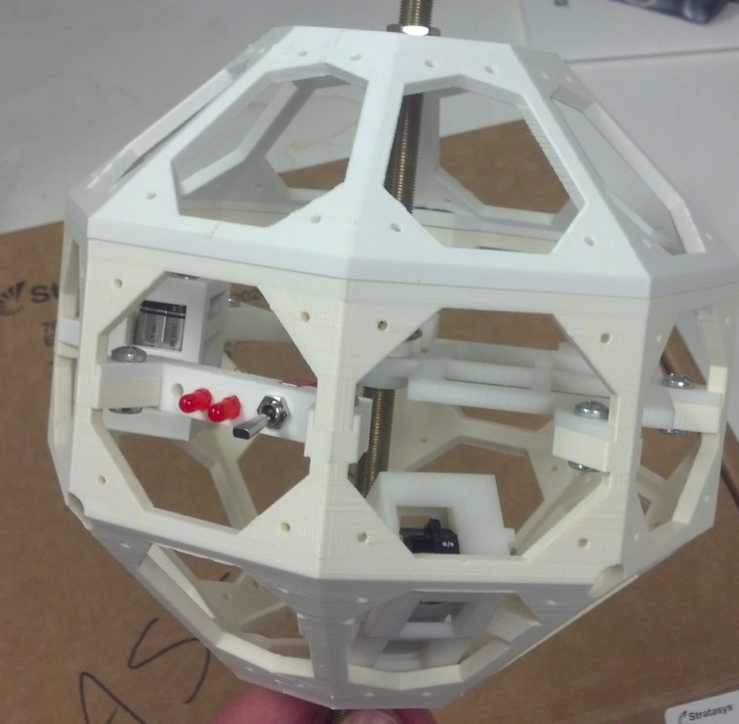
Rapid Prototyping

Slide 9
Fabrication

Slide 10
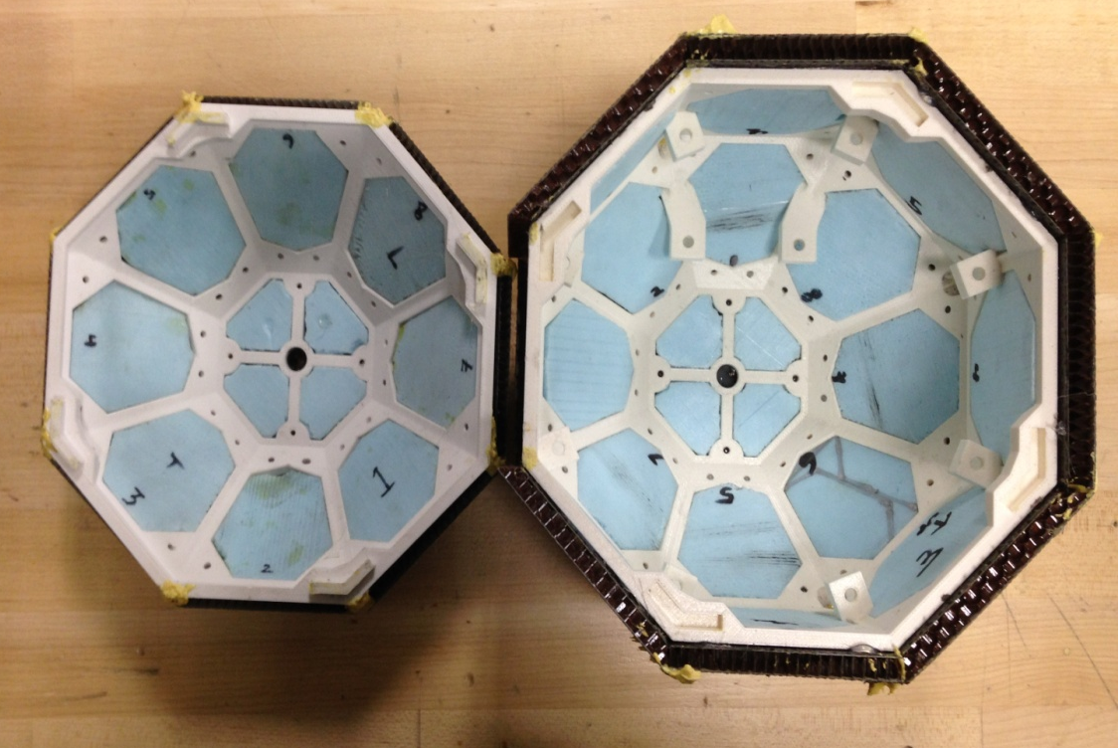
Fabrication
Bi-directional carbon
NOMEX honeycomb
2/10” styrofoam insulation

Slide 11
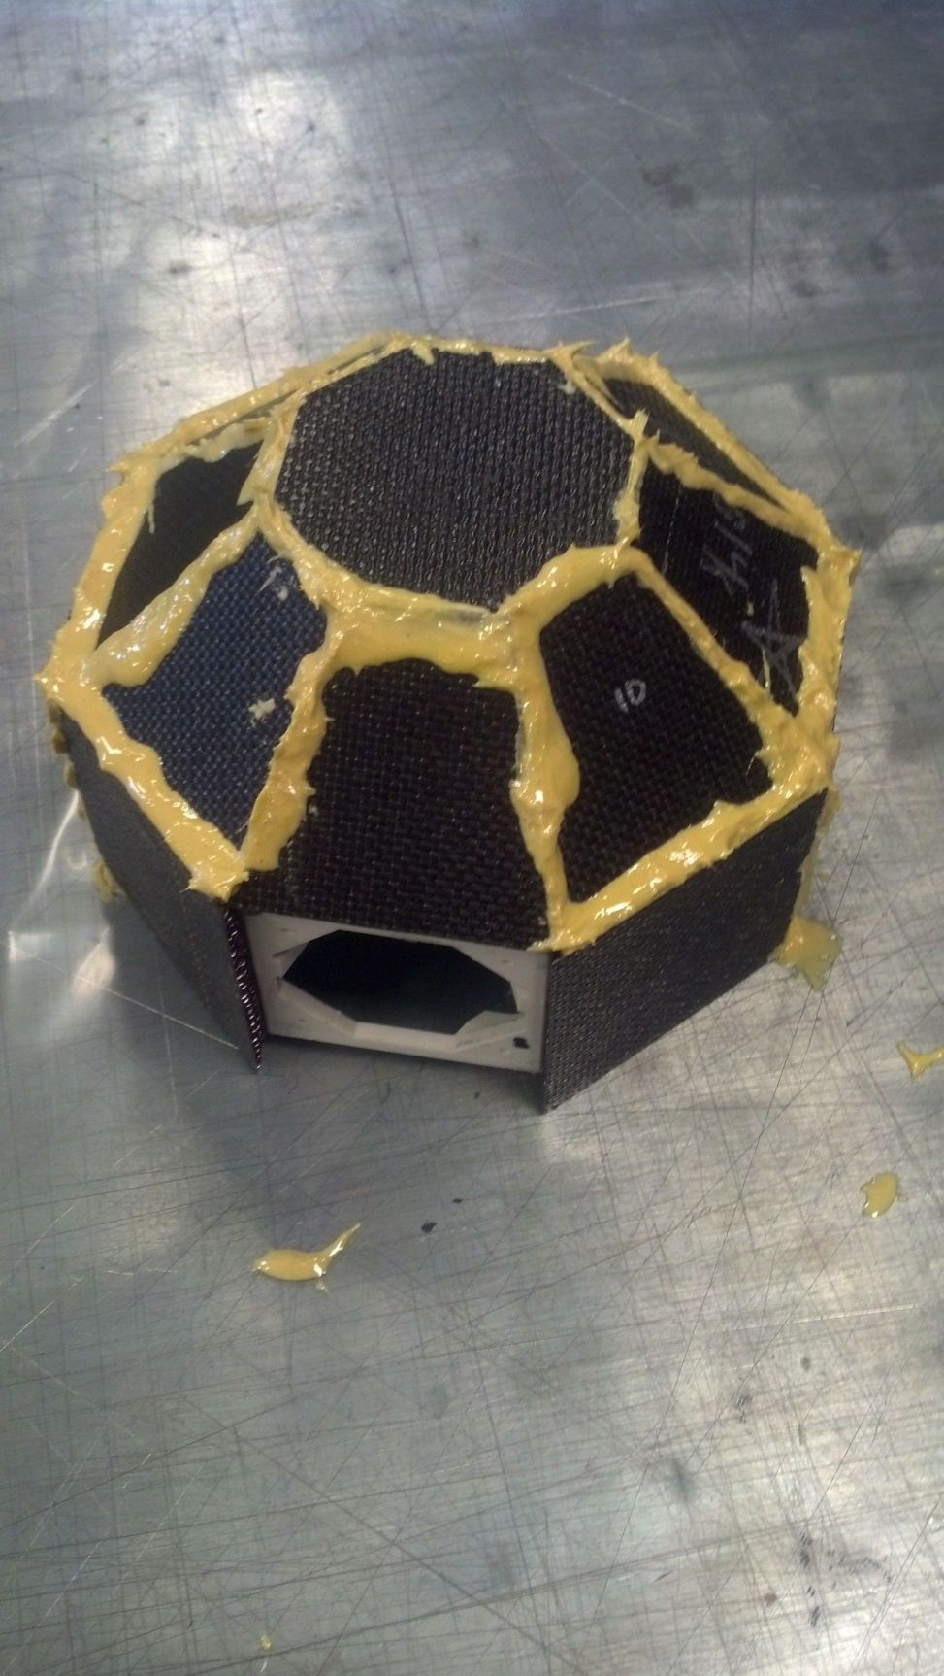
Fabrication
Epoxy
Fiberglass reinforcement
Microballoons

Slide 12
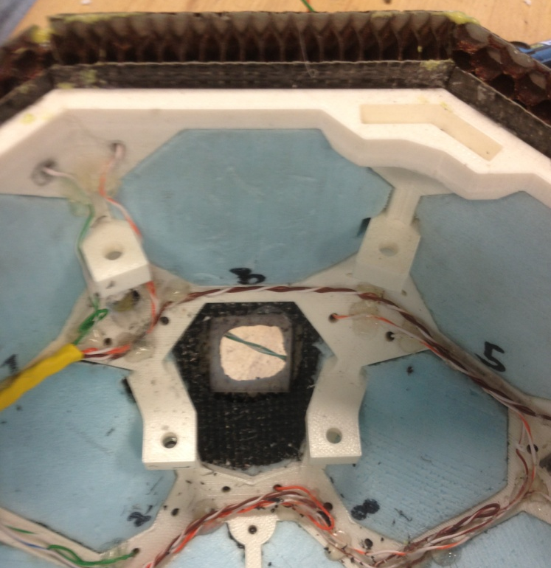
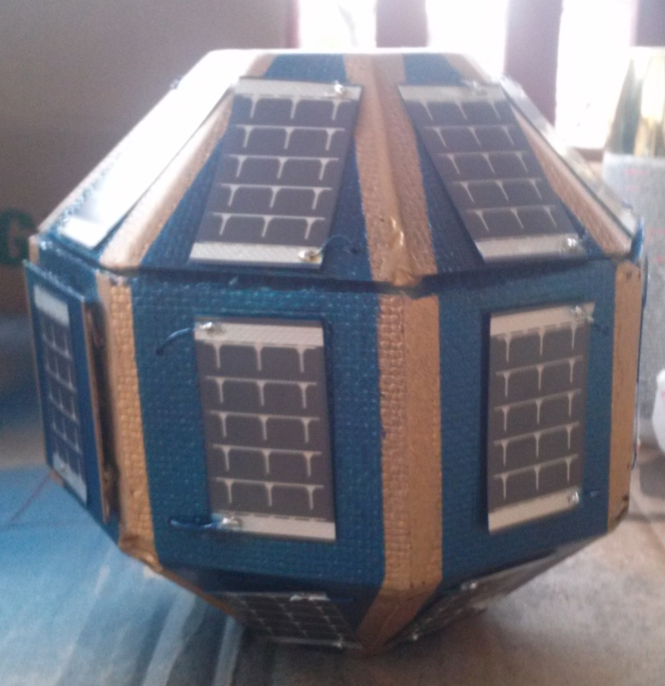
Fabrication
Lexan plate for camera window
Velcro door mechanism

Slide 13
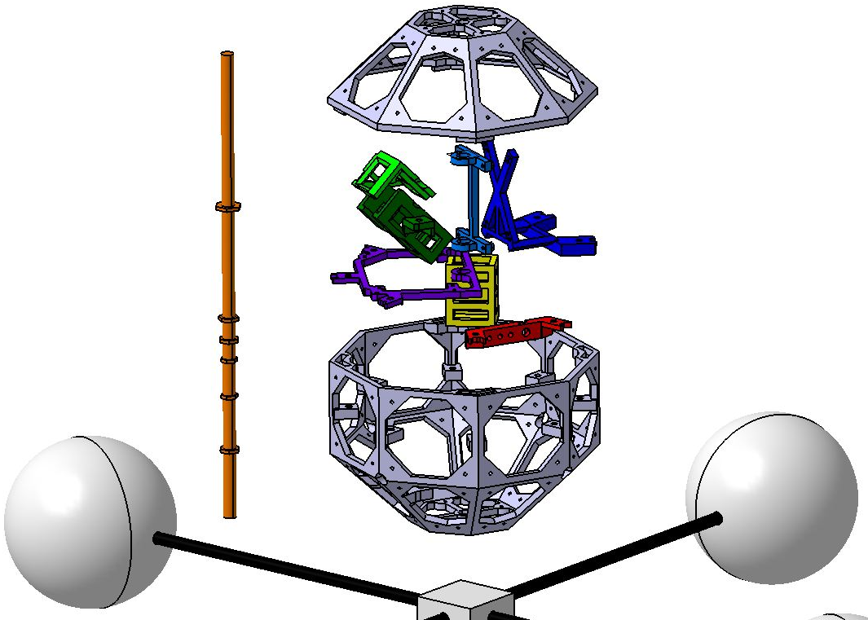
Assembly
All mounts are removable
Bolted into place
Central rod holds all mounts in place
Booms screw into
mounting block

Slide 14
Hardware & Software

Slide 15
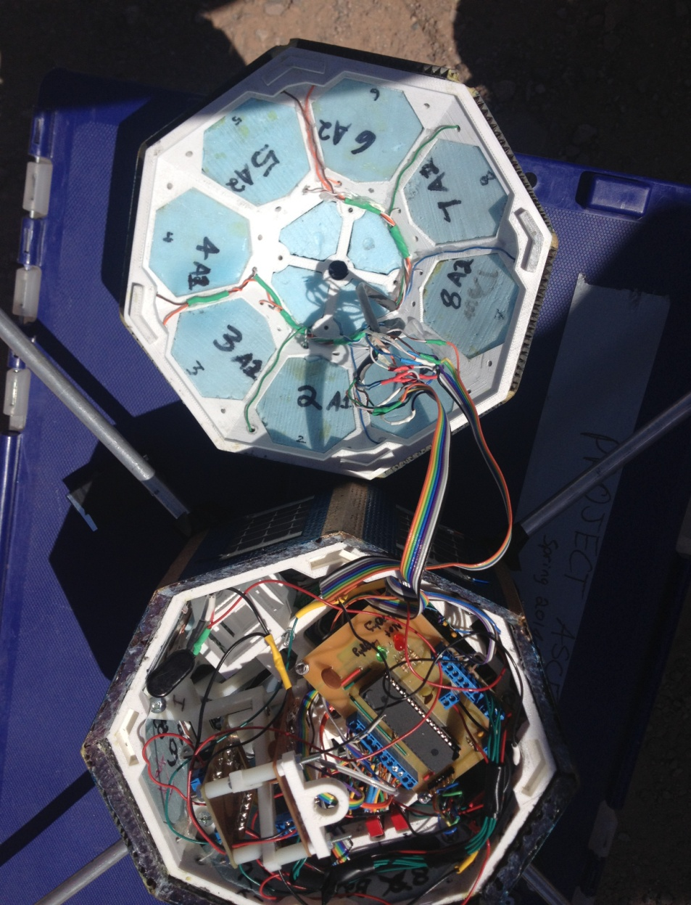
Flight
Software / Hardware
Dr. Isenberg’s data logging system utilizing a PIC processor
3.3V and 5V power regulators
IMU board
PCB – signal routing & conditioning
Video recorder
Data Analysis: MATLAB

Slide 16
Attitude Determination

Slide 17
Attitude Determination
23 solar panels as sun sensors
IMU consisting of a 3-axis rate gyroscope and 3-axis accelerometer
Two vector attitude determination using Wahba’s Problem
  Acceleration Vector
  Sunlight Vector

Slide 18
IMU Calibration
Both rate gyroscope and accelerometer calibrated
Cross-coupling effects considered between axes
Verification of calibration

Slide 19
Light Measurement Vector
Orientation of each panel with respect to x, y, and z axes of gondola (i.e., body frame)
Transformation of data into light measurement vector with respect to the body frame

Slide 20
Flight Results

Slide 21
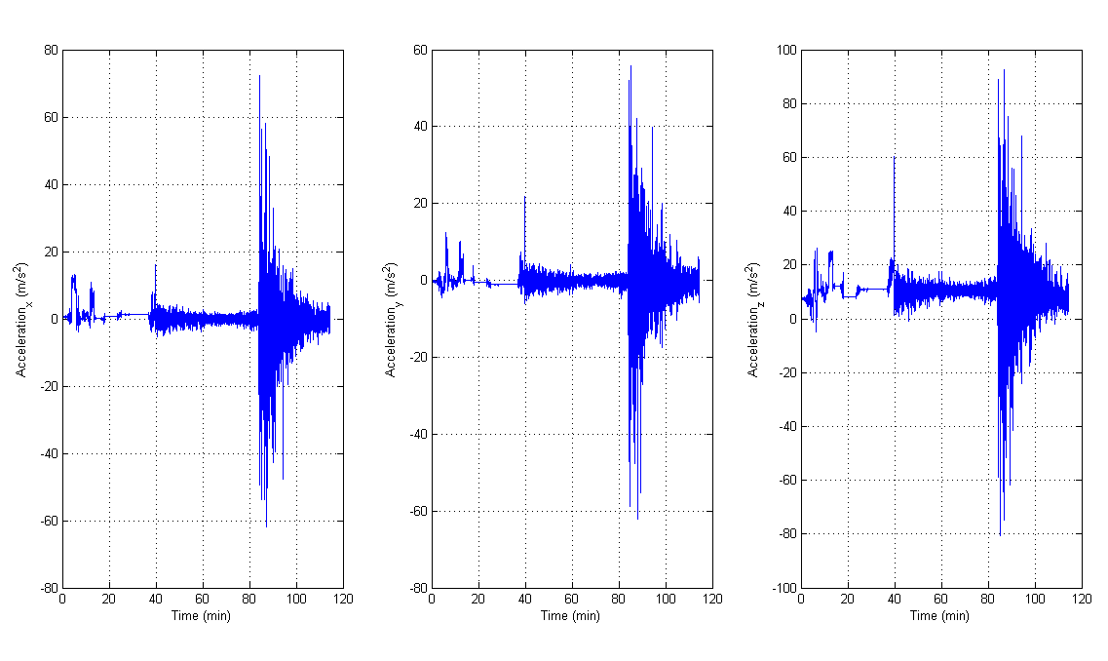
Acceleration Vector

Slide 22
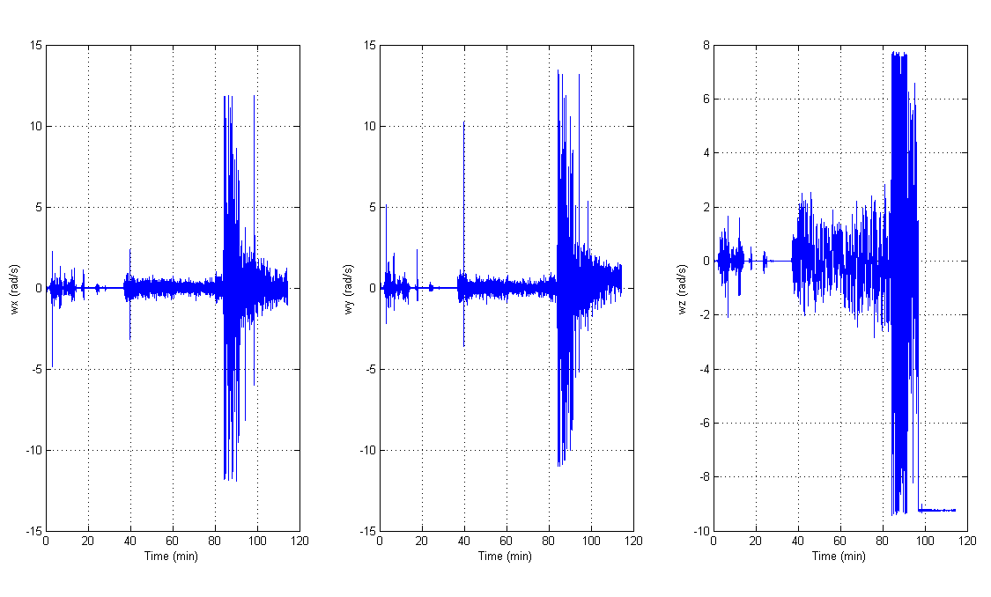
Angular Velocity Vector

Slide 23
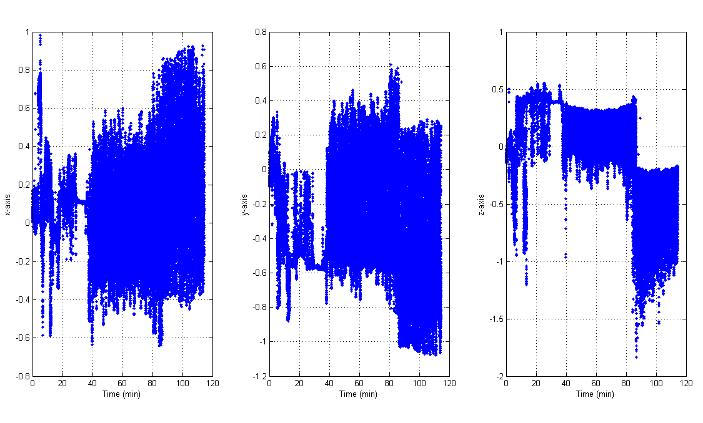
Light Measurement Vector

Slide 24
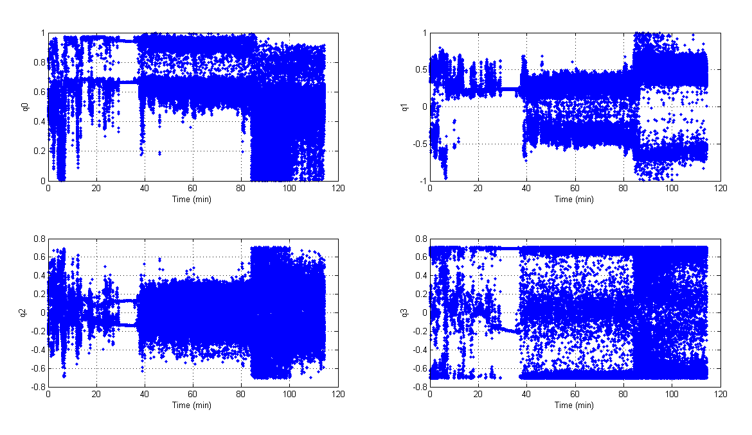
Attitude
(Quaternion)

Slide 25
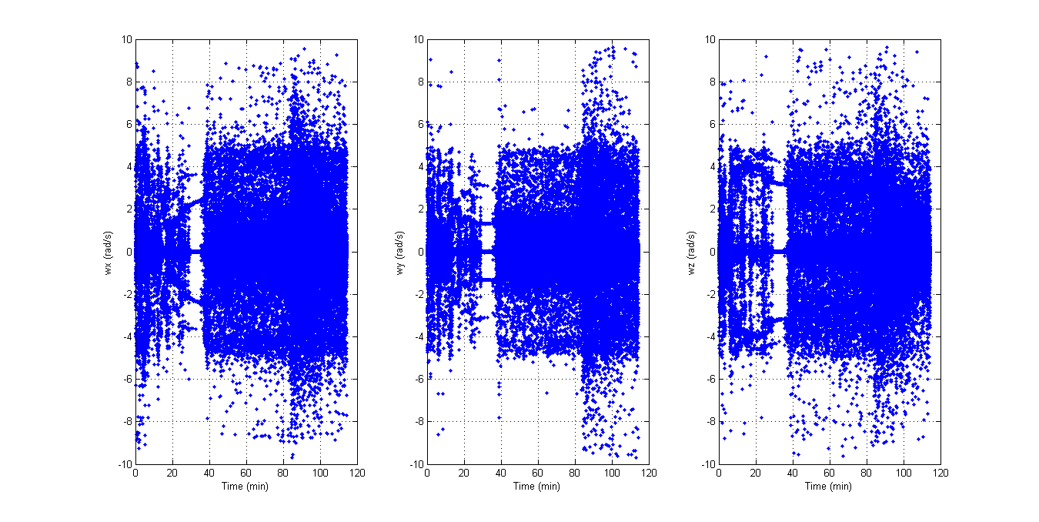
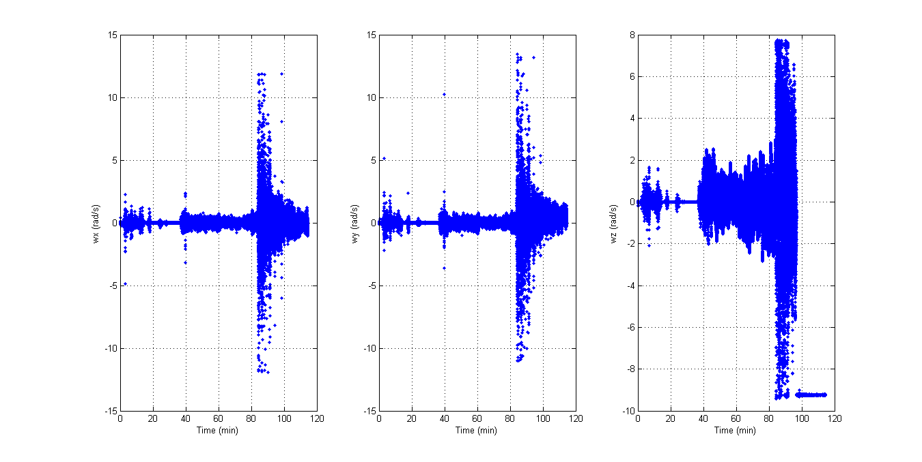
Results Comparison

Slide 26
Future Developments
Recruit more software engineers
Debug I²C
Complete external SD & file system
Real-time implementation
Moving to C++ for libraries containing array math
Determine better attitude estimation algorithm
Attitude control

Slide 27
Acknowledgements
Jack Crabtree – ERAU & ANSR
Dr. Gary Yale - ERAU
Dr. Douglas Isenberg - ERAU
Jim Weber – ERAU
Dr. Brian Davis - ERAU
Patrick David - ERAU
Chris Smith – ERAU
Ben Ellefson – Powerfilm Solar
NASA Space Grant Members
University of Arizona

